Slide 1

SOCIAL MEDIA STRATEGY
Here is where our presentation begins

Slide 2

1- Set Social Media
Goals

Slide 3
Our social media goals
1- Increase brand awareness
When creating brand awareness this leads to increased sales
2- Drive traffic to our website
advantage of attracting visitors to our website by social media
3- Boost brand engagement
Engagement Rate = (Likes + Comments)/ Followers X 100
5- Leads acquisition
4- Grow Sales
A sale is not expected the first time a potential customer encounters our product online.
convert our audience into paying customers directly when they see our products

Slide 4
Increase brand awareness
Brand awareness is the main reason why marketers use social media. When creating brand awareness this leads to increased sales as more sales increase the proportion of the brand in the market. Social media is one of the best places to attract consumer attention because the average person spends approximately two hours on social media daily for this reason it is necessary to focus on Develop brand awareness by creating original content, custom promotions aimed at a custom audience, potential stereotyping, product development based on social insights, and communication strategies adapted to social demographic characteristics of interest. Potential metrics to measure brand awareness: 1- Number of followers - How many people can you reach?
2- Access to your social media posts - How many people arrive every day / week / month?
3- Mentions, sharing, and conversations - How many people talk about our brand or share our posts on social media?
When creating brand awareness this leads to increased sales

Slide 5
Drive traffic to our website
When our brand has a presence on social media, we have the advantage of attracting visitors to our website, who may turn to our customers. Out of every five marketers on social media, three of them work to distribute their content and increase traffic to their sites. For example, a team at HubSpot was able to increase their blog traffic by 241% over an eight-month period through social media.
Potential metrics to measure traffic:
1- Traffic from social media - How many visitors are coming from social media?
2- Clicks on our social media posts - How good are the comments on our social media posts, and how many clicks on these posts?
3- Total traffic - how much traffic does social media represent on our site?
How to measure traffic to your website:
Google Analytics can be used because it is one of the easiest tools to track web visits. It provides information about website traffic from various traffic sources, including social media.
advantage of attracting visitors to our website by social media

Slide 6
Boost brand engagement
There is a point mentioned in the previous slide: When there is good customer service on social media, this helps to increase revenue and customer satisfaction and retention. Moreover, social media algorithms, such as those on Facebook and Instagram, prioritize posts that are highly interactive. If you want people to see your posts on social media, you must produce original and interesting content and respond to your community.
Potential metrics to measure engagement:
1- Likes, shares, and comments per post - How many people interact with our posts on social media?
2- Mentions and responses - How many people have mentioned your brand, and how many have responded?
How to track engagement:
We can track interaction metrics manually through the same social media platforms or a social media analysis tool can be used to help us. Like phlanx or Buffer Analyze, you can sort your posts by likes, comments, or share rate.
Engagement Rate = (Likes + Comments)/ Followers X 100

Slide 7
Grow Sales
convert our audience into paying customers directly when they see our products
We can use social media to convert our audience into paying customers directly when they see our products. For example, advertising on Facebook has become a popular strategy for boosting sales.
Possible metrics to measure revenue growth:
1- Subscriptions / Revenue - How many subscriptions or how much revenue does our social media platform bring?
2- Revenue from ads - How much revenue does your social media ads bring?
How to track revenue growth:
You can track revenue through Google Analytics again

Slide 8
Leads acquisition
A sale is not expected the first time a potential customer encounters our product online. Using social media is a keyway to bring in potential customers and create value for our brand. The definition of a potential customer is somewhat difficult, but it is assumed that the potential customer has provided a company with a form of information about himself such as his name, email address, and the like. Possible metrics to measure Leads acquisition:
1- Personal information (usually email addresses) that are collected through the means of social communication - how many potential customers who've rounded up through the means of social communication?
2- Participation - How many people have participated in a social media contest or event and have shared their information with you?
How to track revenue growth:
You can track revenue through Google Analytics again
A sale is not expected the first time a potential customer encounters our product online.

Slide 9

2- Evaluate our
social media budget

Slide 11
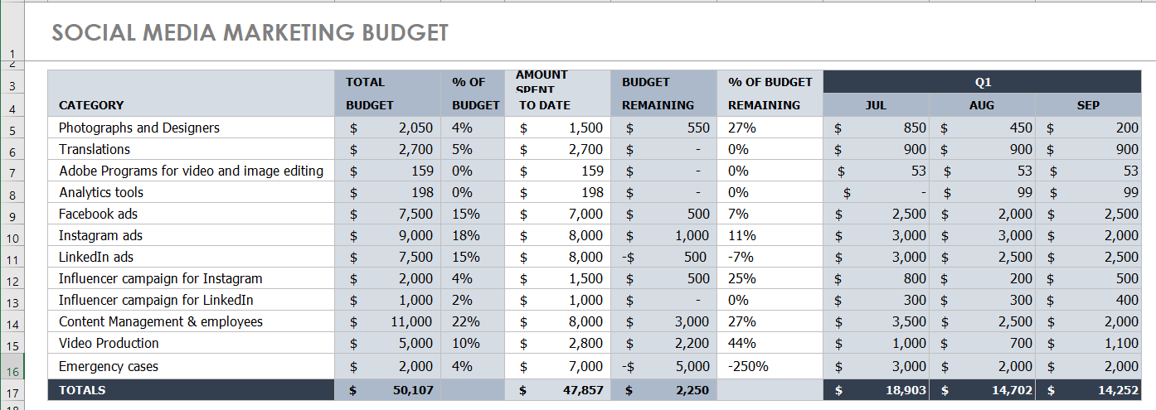

Slide 12
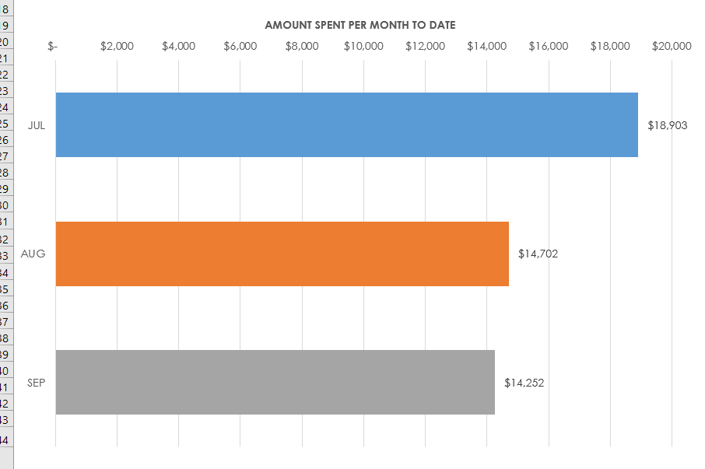

Slide 13
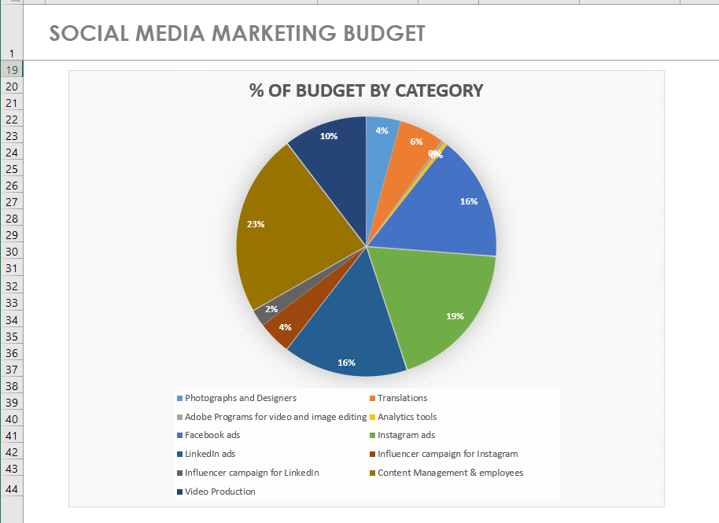

Slide 14
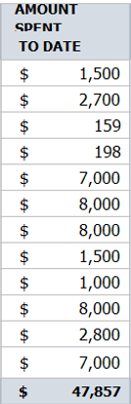
Compare Actual vs. Planned Spending
After budgeting for the social media plan, we tracked our spending all the time. And as you noticed in slide 12, according to the company's financial affairs department, we were allowed to spend $ 50,000 on the social media budget, and when planning the expected number, he issued the number in a total of $ 48,000, and after tracking our expenses from the first working day to the last day, we found that we spent Only 40,000 and we have achieved all the targets presented and this indicates successful budget and good money management

Slide 15
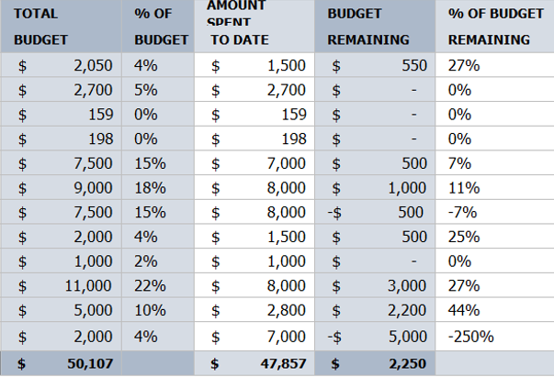
Review our Financial Goals
As we saw in Slide 12, there is a surplus of $ 10,000. We used $ 7000 of excess, for emergencies and to achieve our goals in a professional manner and to the maximum extent, the total that was used to achieve the goals in professional manner was $ 47,000.

Slide 16
3- Create a buyer persona

Slide 17
Audience research
Firstly to create buyer persona we must do audience research. As first step we have to determine who use our products or services. Some of the key data points you’ll want to collect are age, location, language, income, buying behavior, interests and activities, and life stage. .
Who use our products or services | Key data about our costumers :
1- Total Turkey | Average employees age: 25 - 55
2- ZF Turkey. | Location: Turkey
3- ZF Sachs. | Language: Turkish, English
4- Possible SFT | Income: ₺39,998
5- Sir Deterjan. | Bonus: ₺10,000
6- Fantom. | Interests: Marketing & Advertising
7-Seba kimya | buying behavior: They buy Software’s, Videos, Social media advertising and creative
8- Anatolium AVM, Ada AVM, Tarsu AVM, Tekira AVM and Teras Park AVM | Background: Head of Marketing & Advertising and worked at same company at least 5 years
After collecting basic information about our customers, we should search on our website. The website analysis tools can provide an incredible amount of information about people who interact with our brand by email or communicate with customer service even if they are not yet customers.

Slide 18
Identify customer pain points
What problems are our potential customers trying to solve? What prevents them from succeeding? What obstacles do they encounter in achieving their goals?
One of the main ways to find out is to find out what people are saying about you online. You can find out why they love our products, or what parts of the customer experience don't work. It's also a good idea to check with our customer service team to see what kinds of questions they get most. You can also ask them to collect true customer quotes that you can use to help give your audience's personalities depth.
Challenges in our potential customers | Customer quotes
Focus To details of things | we don't want to push our ideas on to of production companies, we simply want to make them make what they want for creativity
Missing of some potential customers | Social media marketing is the future
Work life confusing | we had to deal with a lot of production companies to find the perfect marketer
Want to get things done causes our stress when we have too many tasks. | When dealing with companies, we are faced with problems until we understand each other, but companies always try to understand us

Slide 19
Identify customer goals
Objectives are positive things your customers want to achieve. These goals may be personal or professional, depending on the types of products and services you sell. What motivates our customers? Just as your customer service team has been a good source of insight into pain points, the sales team can be a good source of insight into customer goals.
Customer Goals
Get more customers by social media advertising
Make high-quality marketing videos to attract potential customers
Providing support to the social media and marketing department
Motivating the media companies to create creativity in order to help us attract more customers

Slide 20
Understand how we can help
Having understood our customer points and goals, it's time to create a truly clear picture of how our products and services can help. We must think about how the feature is what your product or what it does. The benefit is how your product or service makes the customer’s life easier or better.
How we help | Elevator Pitch
Provide high-quality videos and advertising images to bring potential customers to our advertisers | We give you a perfect Social media marketing plan with Creative ideas and high-quality videos and advertising images to bring all potential customers, with meetings to understanda all your points of view.
Submit a free plan to our advertisers on the way to motivate the social media and marketing departments of their companies
Meeting with advertisers to understand their point of view and what they want to achieve it
Offering excellent marketing to customers with an emphasis on detailing things to satisfy them

Slide 21
Turn our research into buyer personas
Osman Kibar persona
Background
Head of Marketing & Advertising
Worked at same company at least 5 years
Buy software’s, Videos, Social media advertising and creative
Interests: Marketing & Advertising
Have 2 Children (10 - 15)
Challenges
Focus To details of things
Missing of some potential customers
Work life confusing
Want to get things done causes our stress when we have too many tasks.
Customer quotes
we don't want to push our ideas on to of production companies, we simply want to make them make what they want for creativity
Social media marketing is the future
we had to deal with a lot of production companies to find the perfect marketer
When dealing with companies, we are faced with problems until we understand each other, but companies always try to understand us
Goals
Get more customers by social media advertising
Make high-quality marketing videos to attract potential customers
Providing support to the social media and marketing department
Motivating the media companies to create creativity in order to help us attract more customers
Demographics
Average employees age: 25 - 55
Location: Turkey
Language: Turkish, English
Income: ₺39,998
Bonus: ₺10,000
City

Slide 22
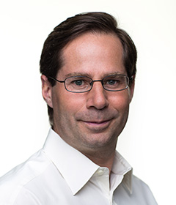
Turn our research into buyer personas
Osman Kibar persona
How we help
Provide high-quality videos and advertising images to bring potential customers to our advertisers
Submit a free plan to our advertisers on the way to motivate the social media and marketing departments of their companies
Meeting with advertisers to understand their point of view and what they want to achieve it
Offering excellent marketing to customers with an emphasis on detailing things to satisfy them
Elevator Pitch
We give you a perfect Social media marketing plan with Creative ideas and high-quality videos & advertising images to bring all potential customers, with meetings to understanda all your points of view.

Slide 23
4- Select social media
networks to focus on

Slide 24
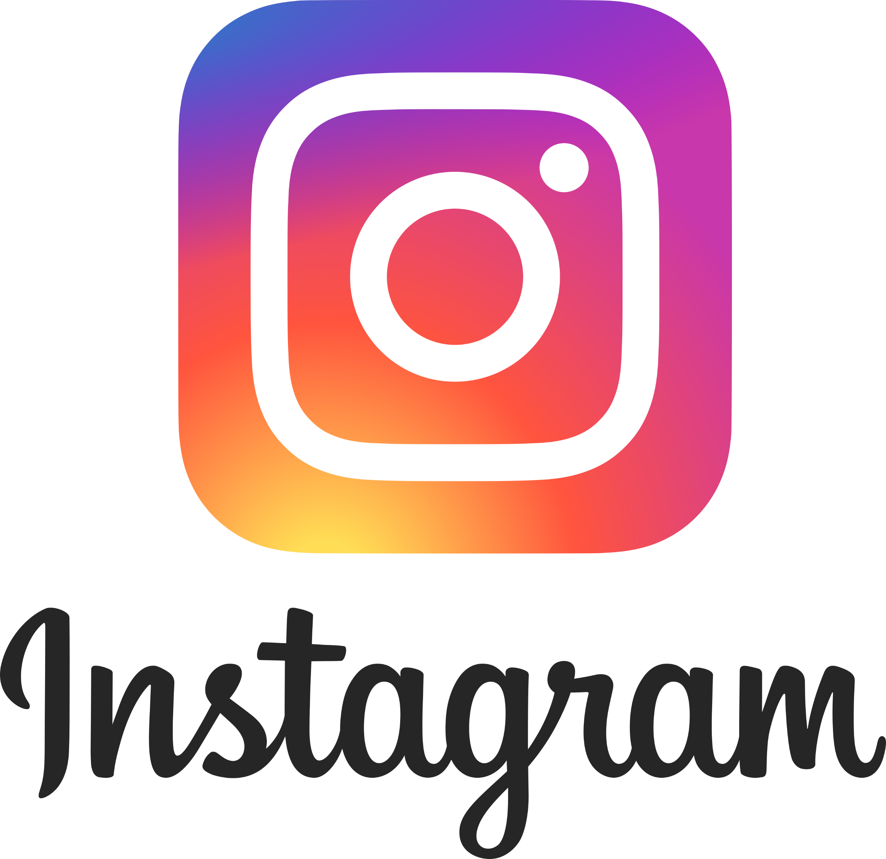


Social media networks to focus on
Instagram
Facebook
LinkedIn
Instagram has more than a billion users according to Ad Espresso, 80% of users follow brands on Instagram.
a third of the world's population uses Facebook and Facebook is one of the best social media platforms companies can use to reach their target market
LinkedIn is one of the best social media platforms for brands because it provides an excellent opportunity for B2B brands

Slide 25
5- Create the content and
set the calendar

Slide 26
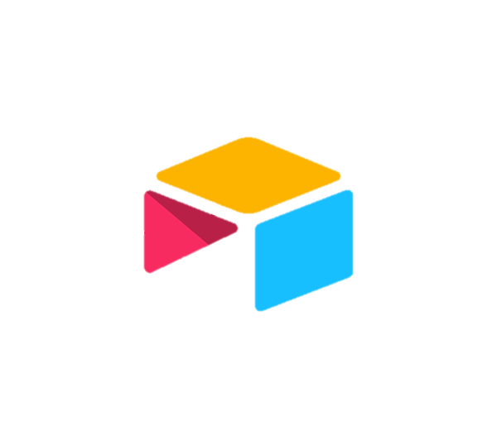
Facebook posts:
Instagram posts:
LinkedIn posts:
https://airtable.com/shrz9s7NVOYr4rE2B
https://airtable.com/shrfKY1cv9Ha23KkG
https://airtable.com/shryjwunknJriYluz
The link for the full Base of Social Media Plan - Step 5
https://airtable.com/shrA51bx2oqUcmD6N

Slide 27
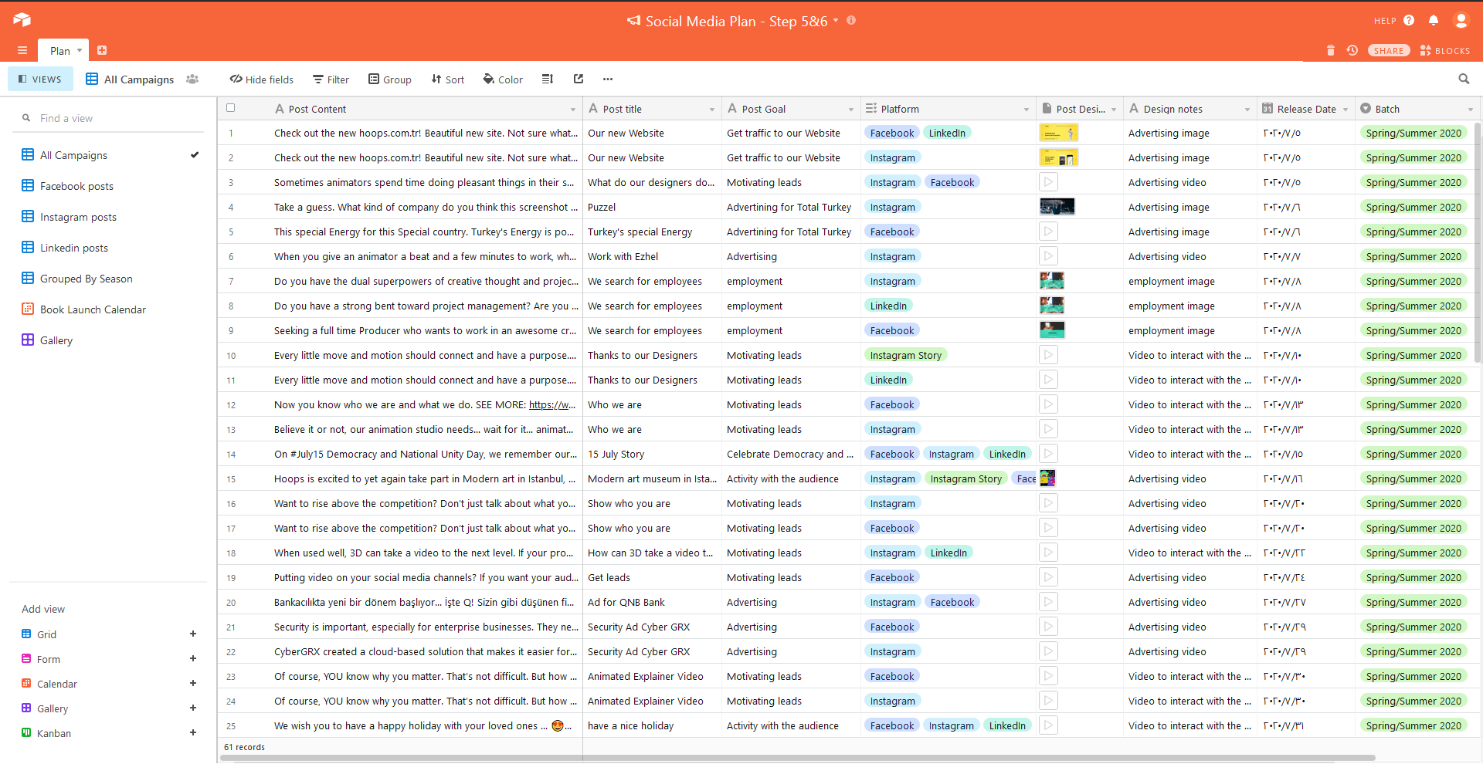

Slide 28
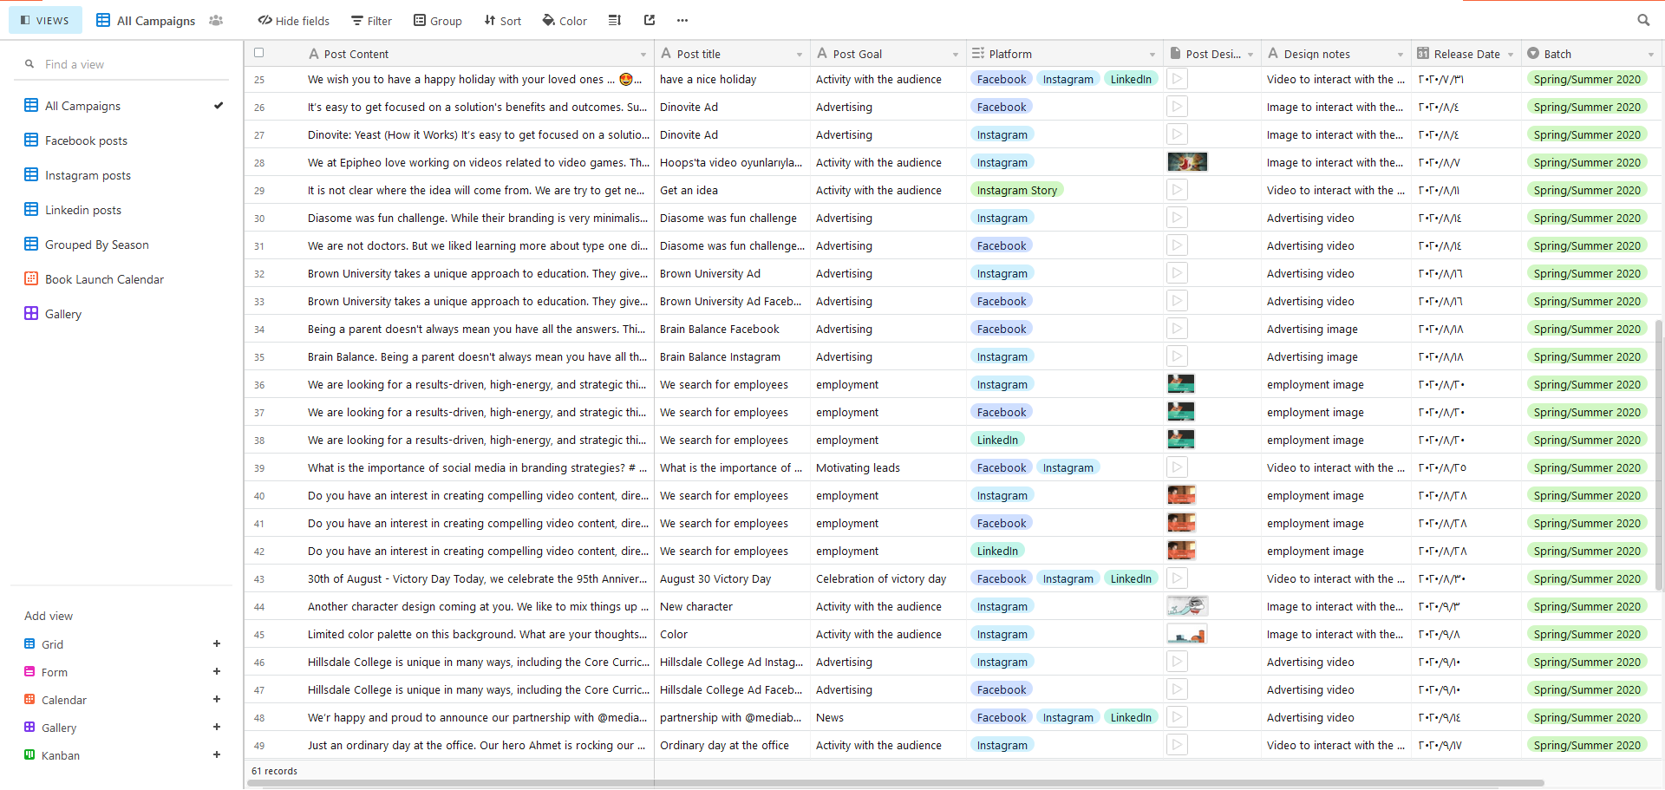

Slide 29
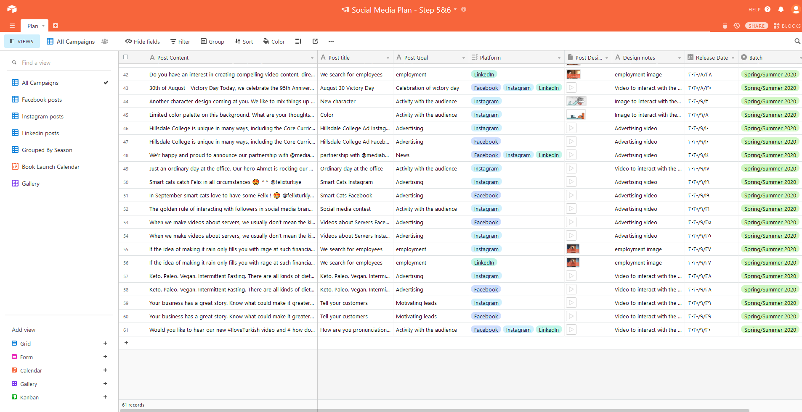

Slide 30
The link for Calendar of Social Media Plan – Step 6
https://airtable.com/shrI0xGjsccQW73IG

Slide 31
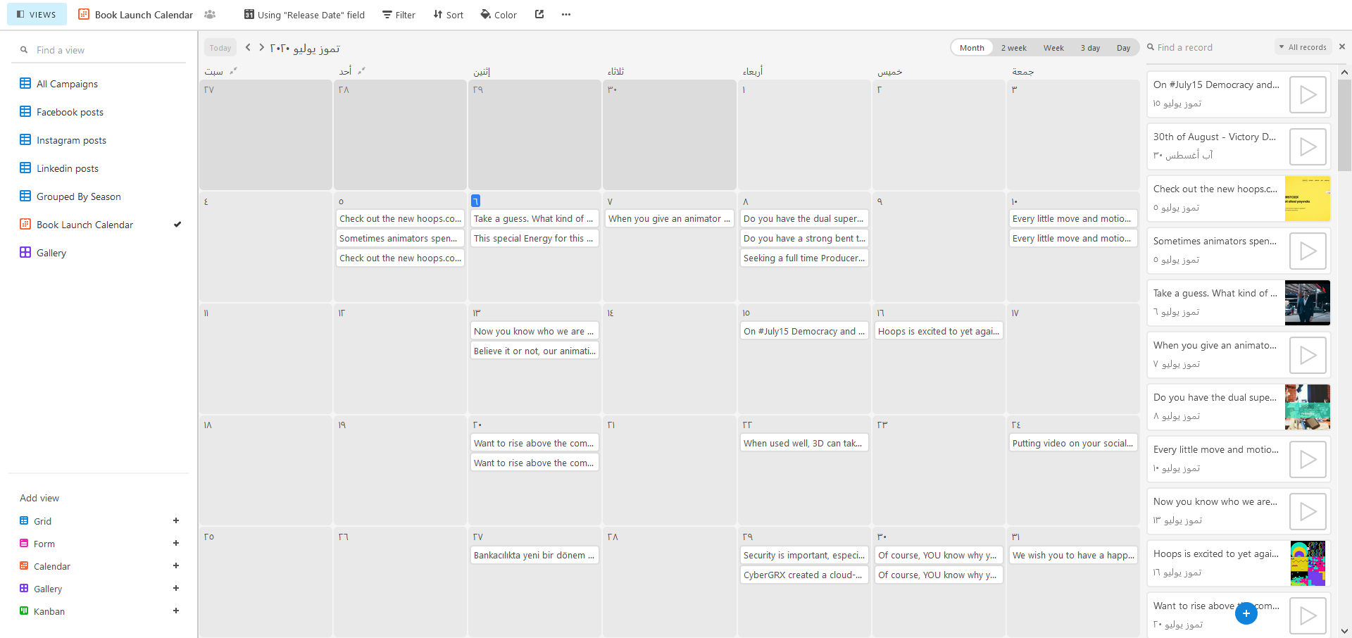

Slide 32
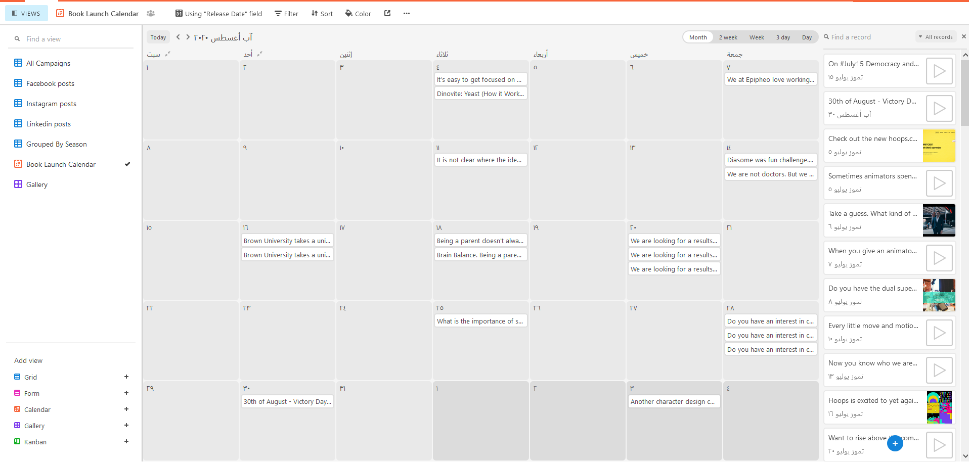

Slide 33
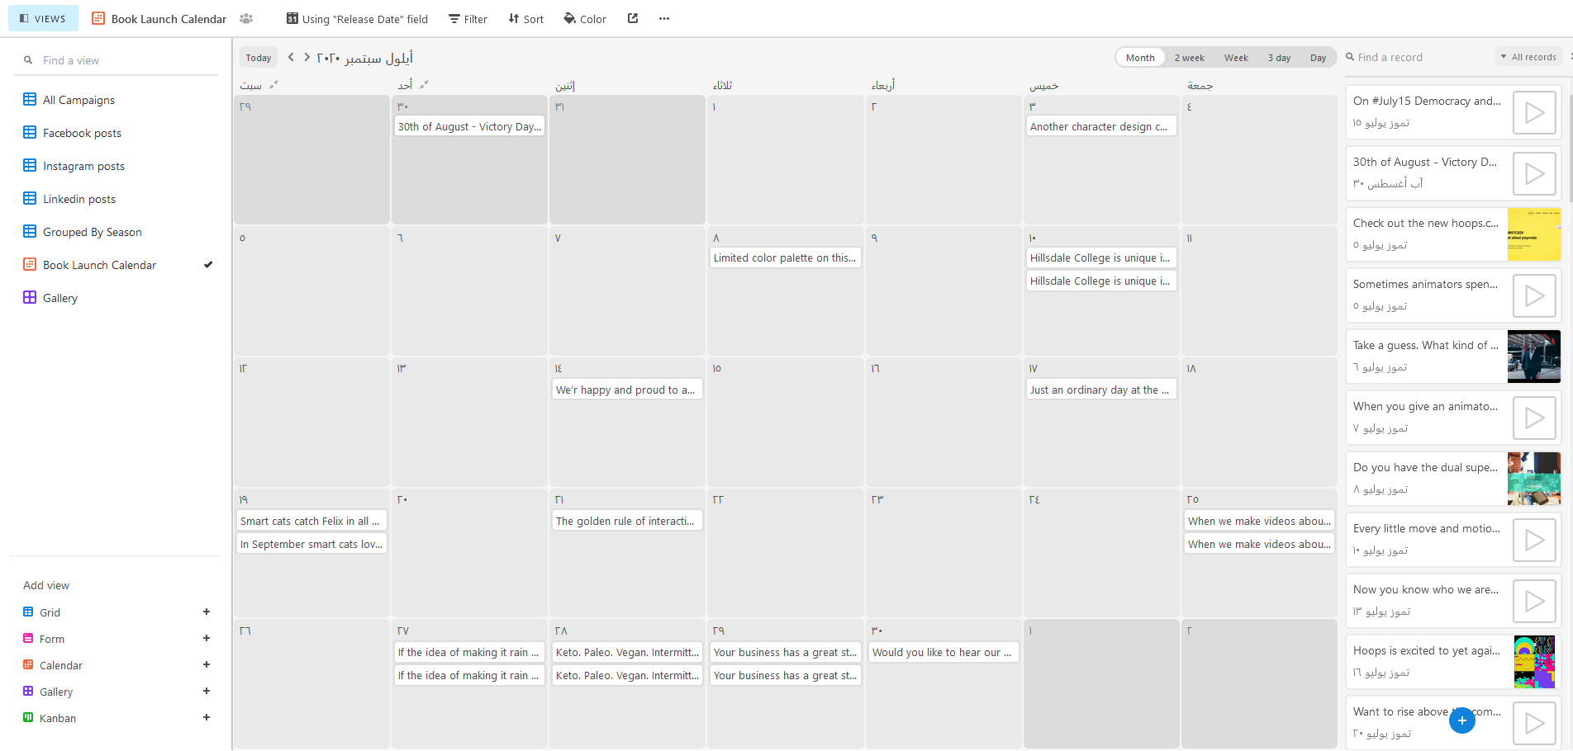

Slide 34
6- Set the visuals roles

Slide 35
The link for Gallery of Social Media Plan – Step 6
https://airtable.com/shrzpjIXYTansb0yW/tblKSKJ4TkJGIvKzs

Slide 36
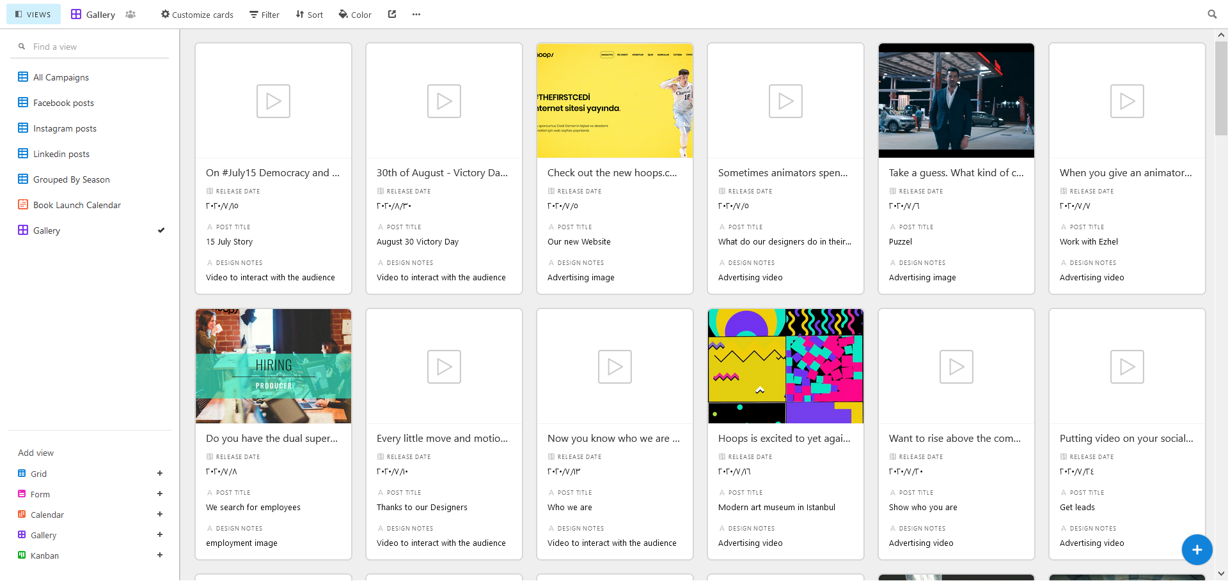

Slide 37
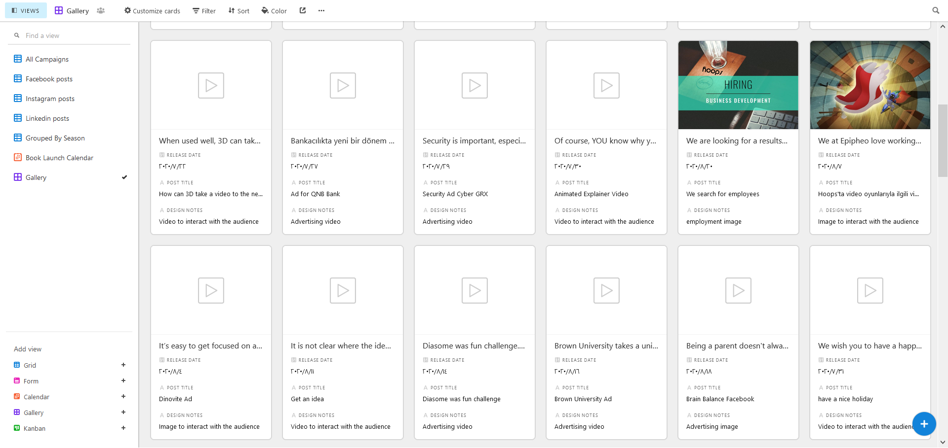

Slide 38
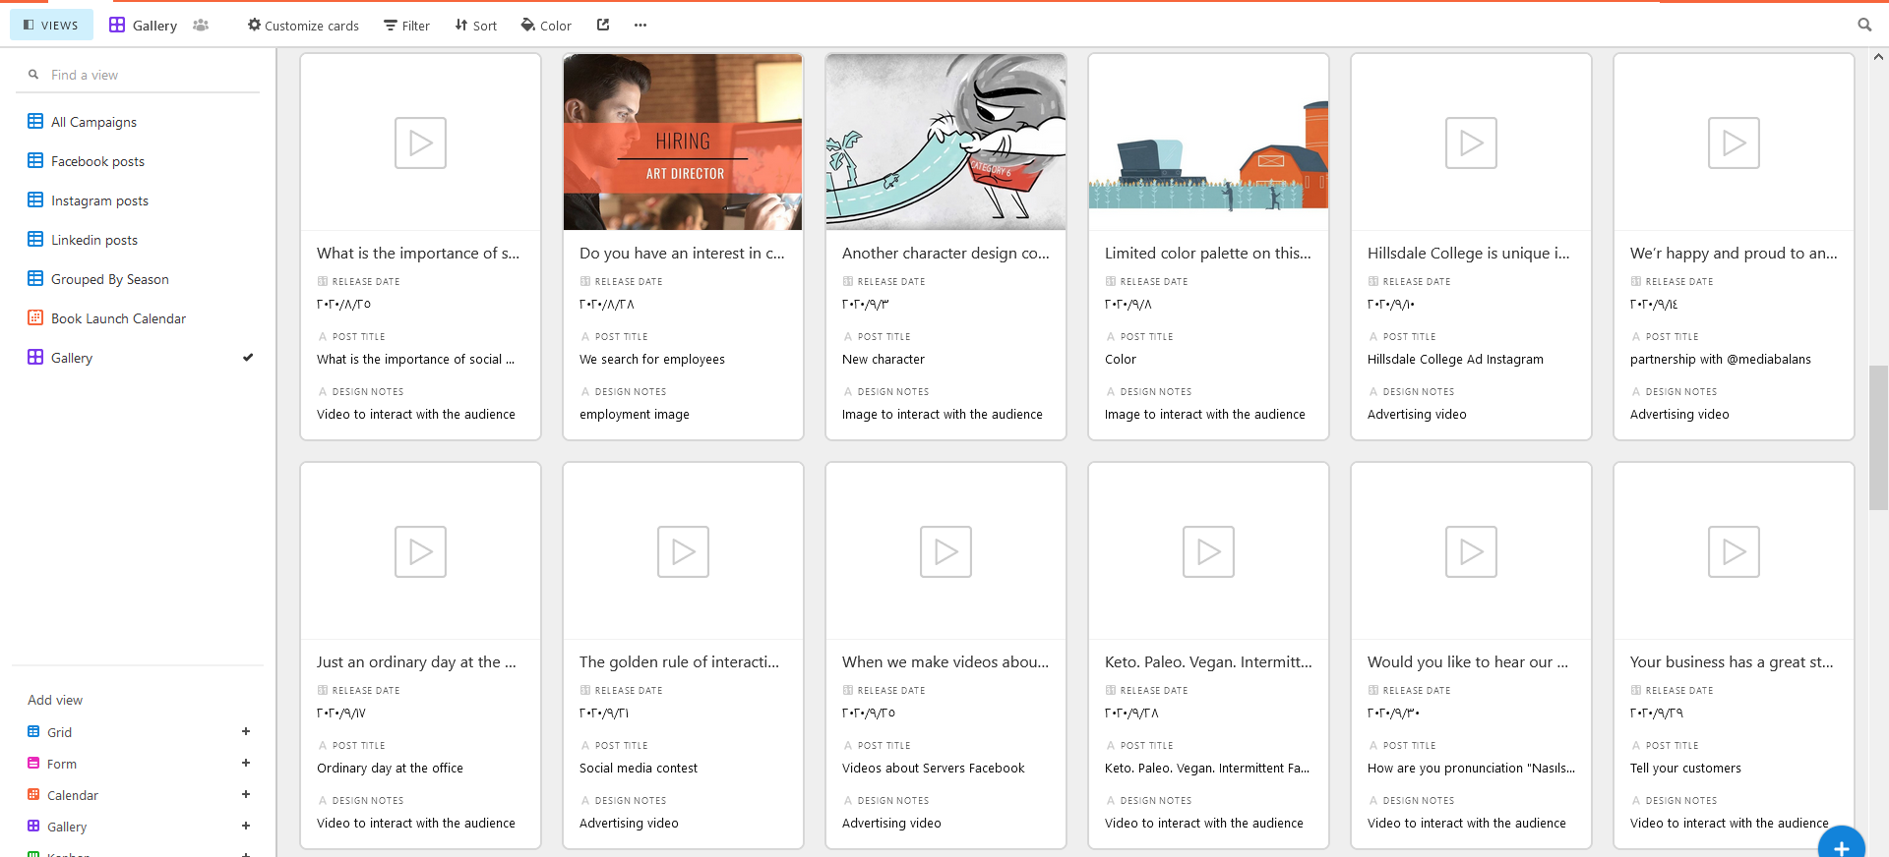

Slide 39
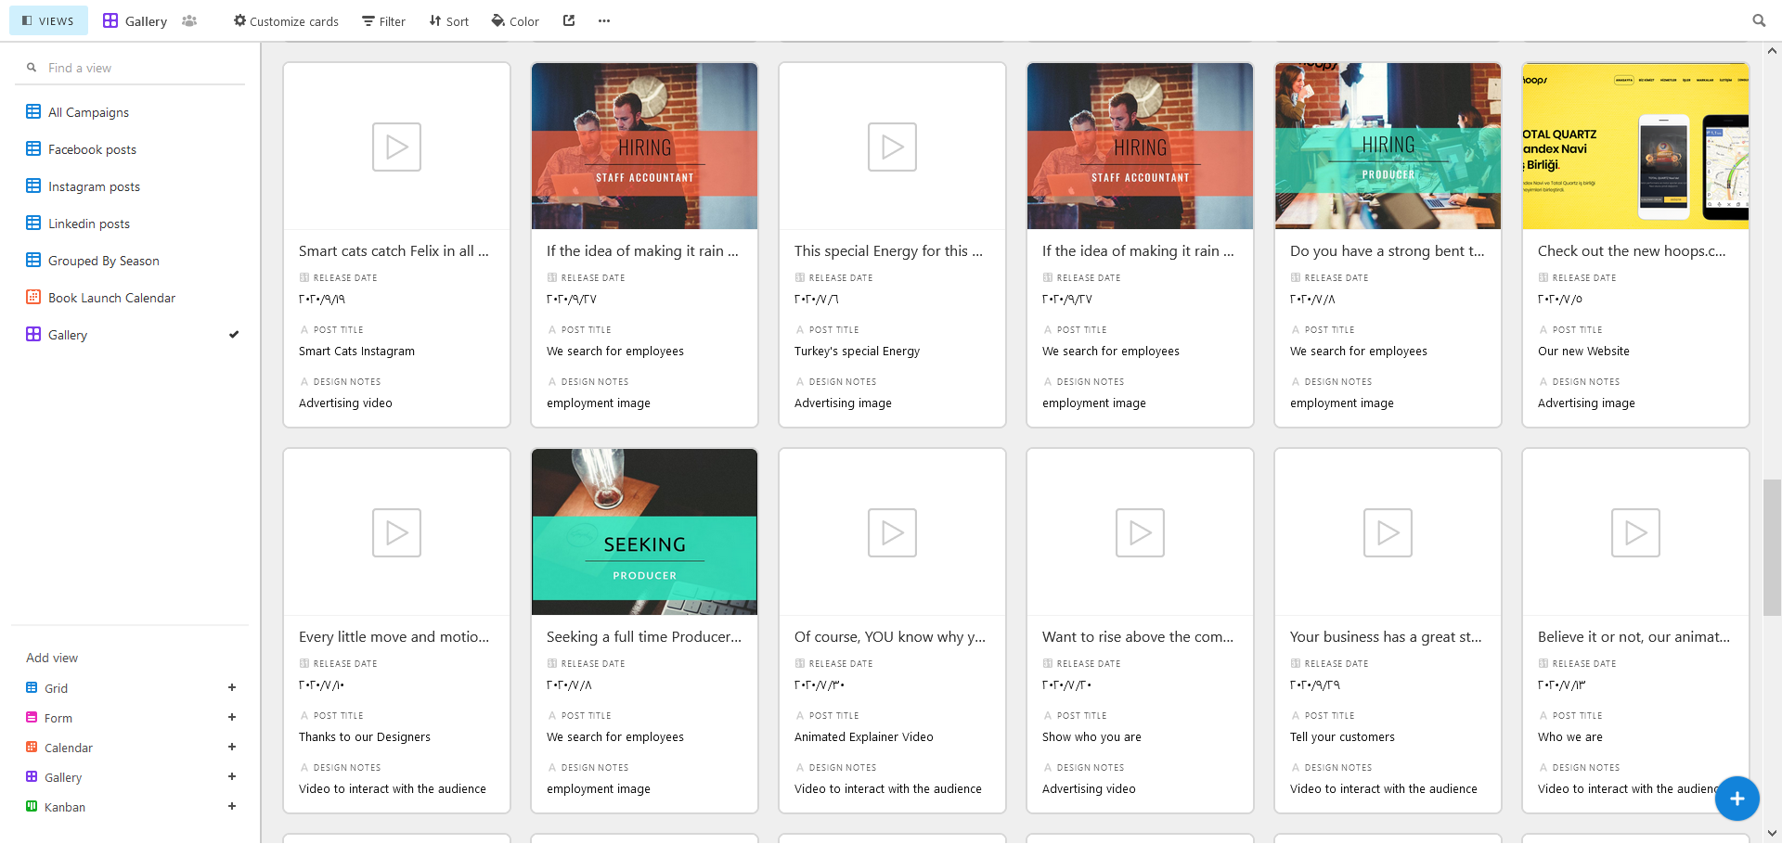

Slide 40
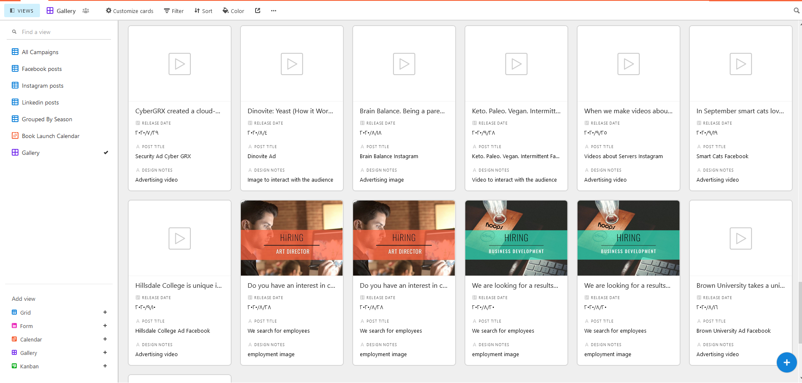

Slide 41
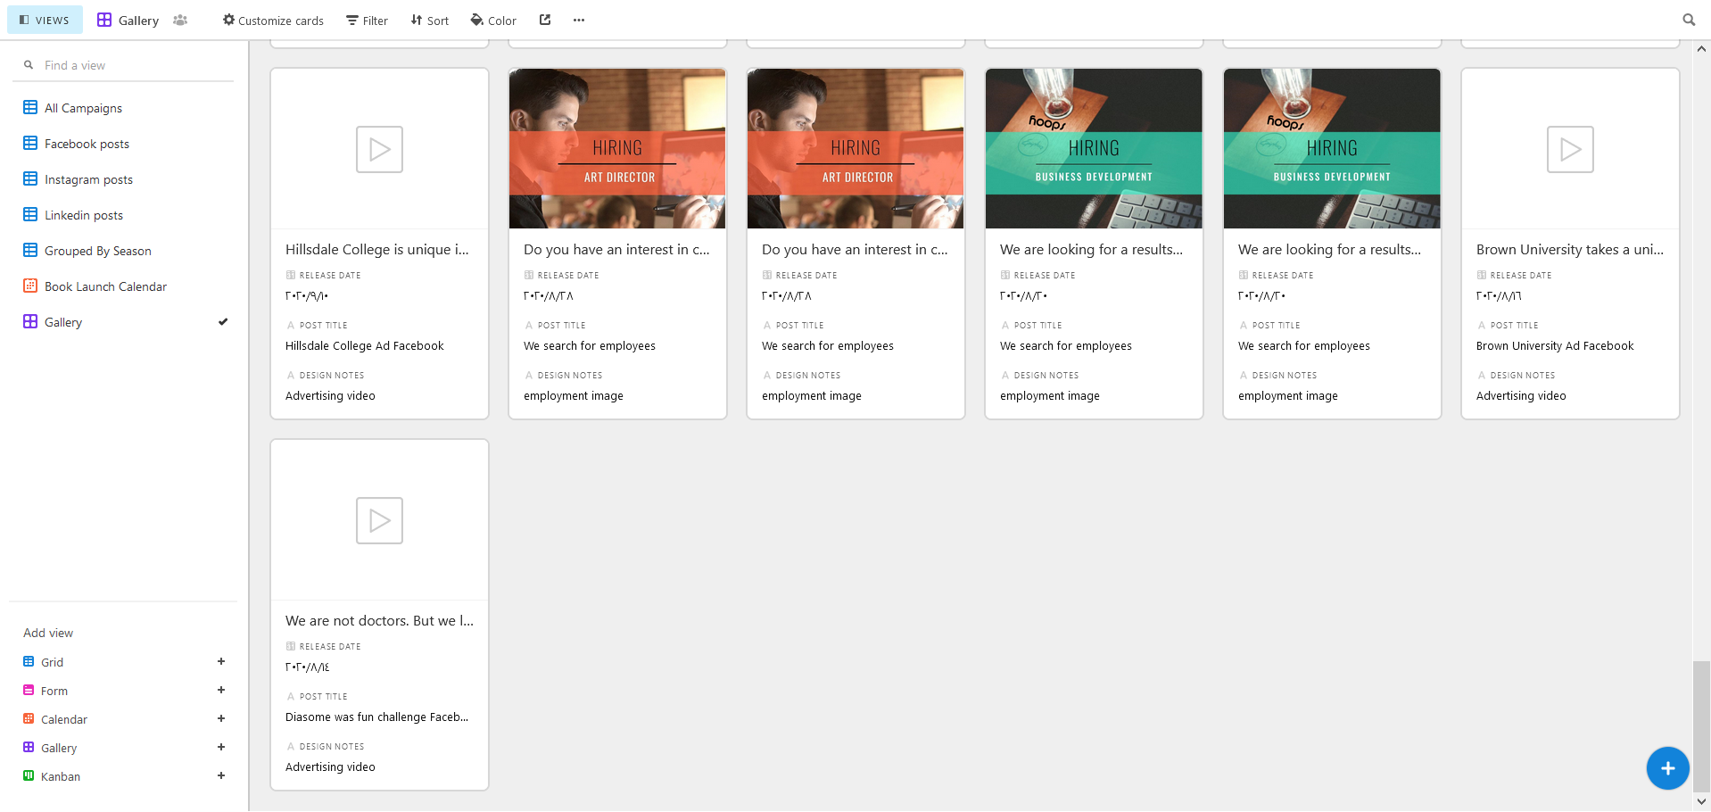

Slide 42
7&8 - Define the KPI & the tools used to measure the KPI

Slide 43
The link for the full Base of Social Media Plan Step - 8 & 9 KPI
https://airtable.com/shreDM4i14f59xW8t

Slide 44
